Slide 1
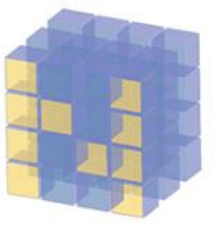
Broadcasting

Slide 2
Reference
SciPy Documentation
Youtube
Code

Slide 3
What is Broadcasting

Slide 4
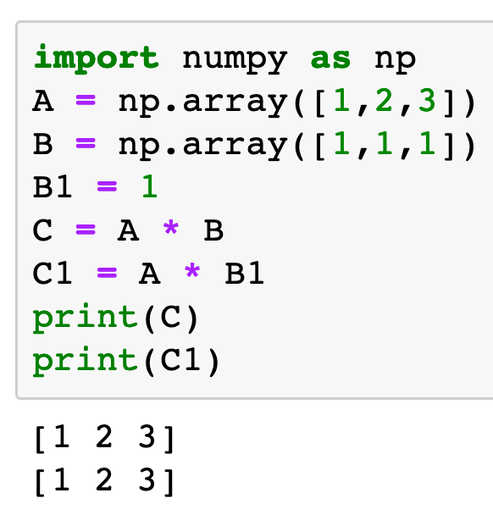

Slide 5
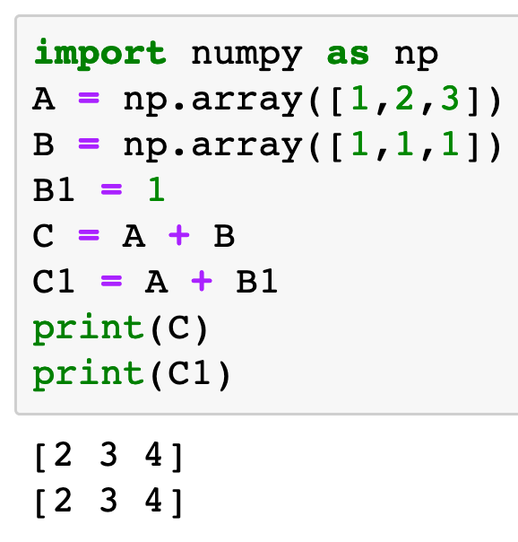

Slide 6
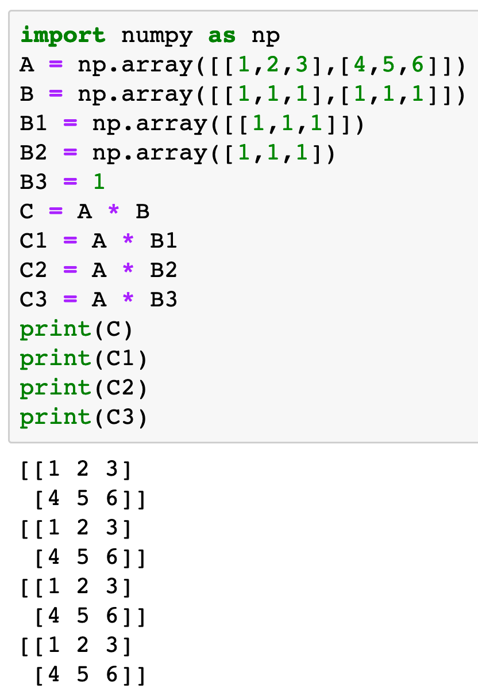

Slide 7


Slide 8
Broadcasting Rule

Slide 9
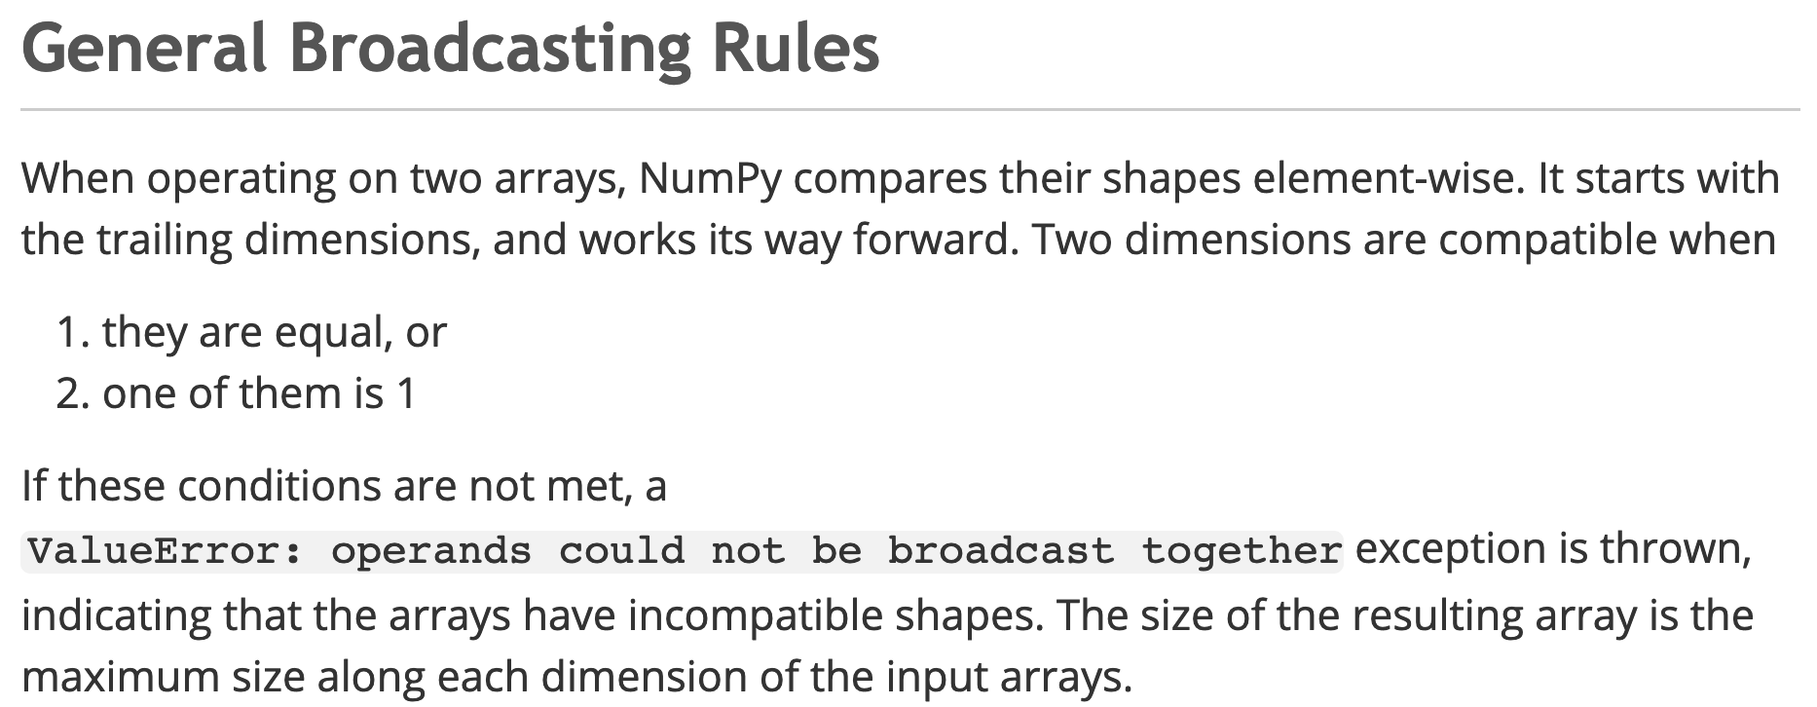
SciPy Documentation

Slide 10
Good Cases

Slide 11
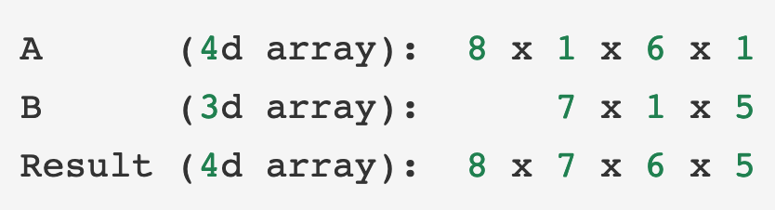

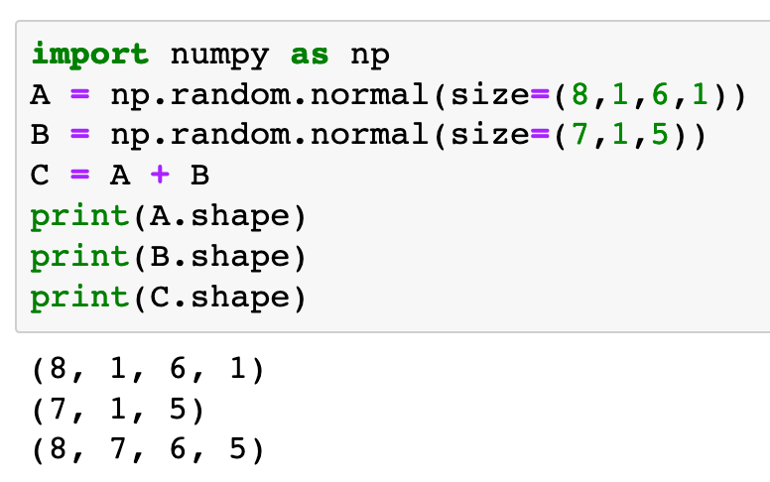
SciPy Documentation

Slide 12
SciPy Documentation

Slide 13
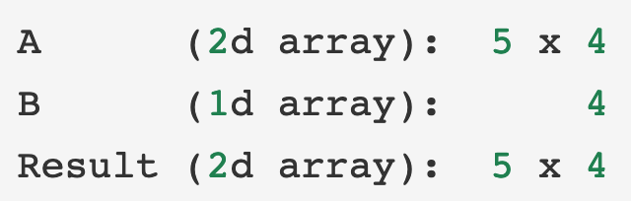
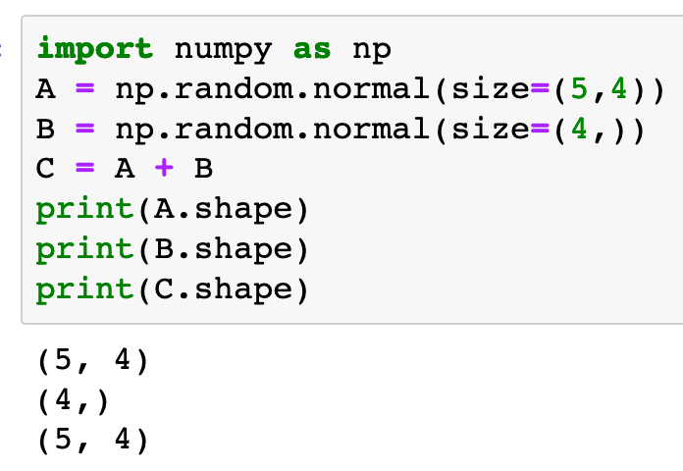
SciPy Documentation

Slide 14
SciPy Documentation

Slide 15
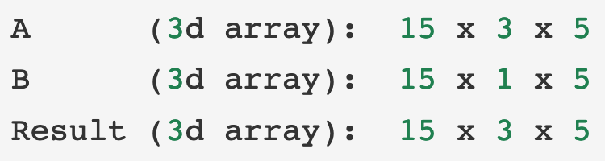
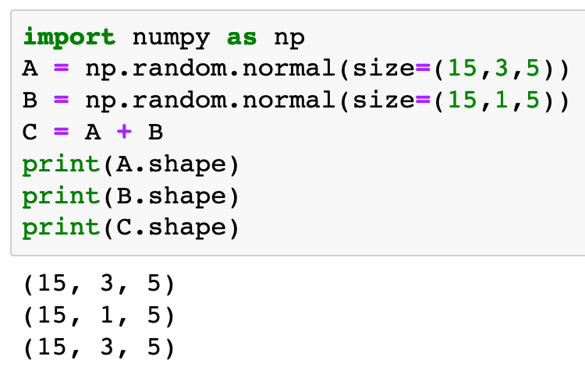
SciPy Documentation

Slide 16
SciPy Documentation

Slide 17
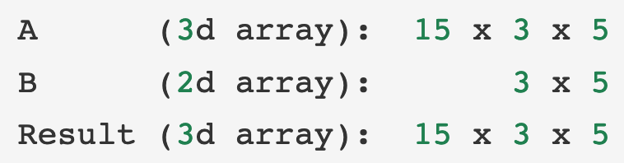
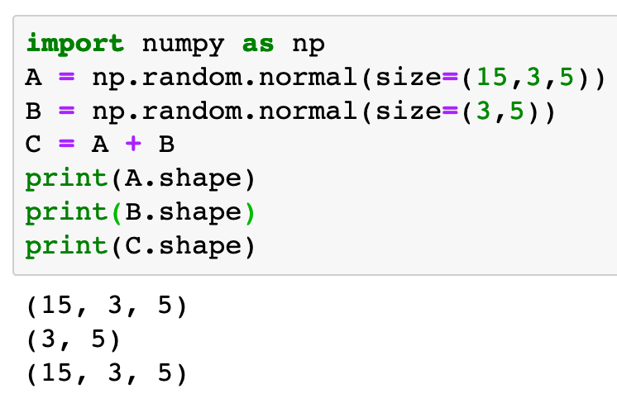
SciPy Documentation

Slide 18
SciPy Documentation

Slide 19
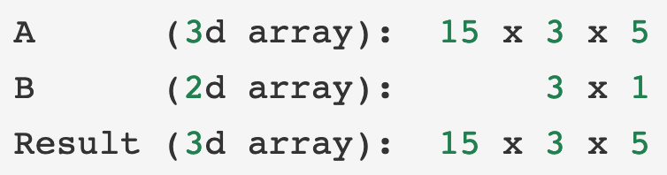
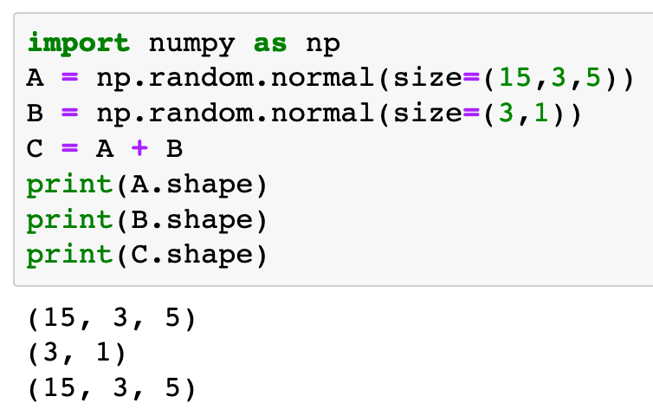
SciPy Documentation

Slide 20
SciPy Documentation

Slide 21
Bad Cases

Slide 22
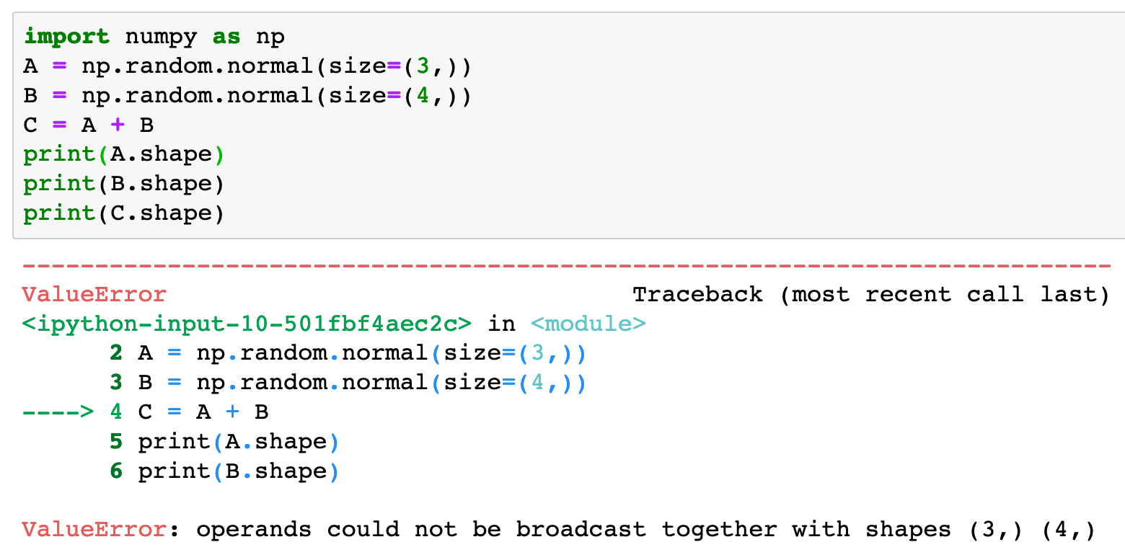
SciPy Documentation

Slide 23
SciPy Documentation

Slide 24
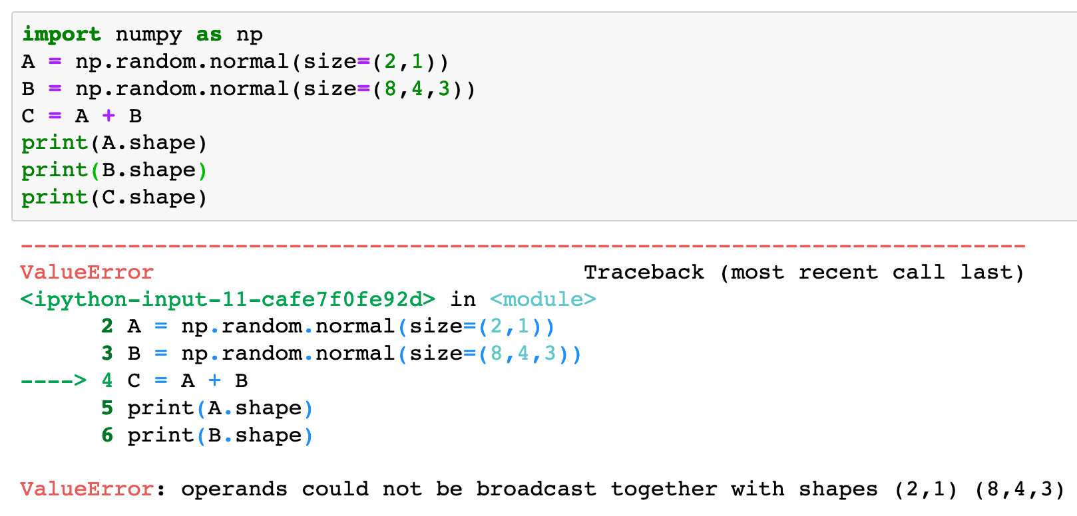
SciPy Documentation

Slide 25
SciPy Documentation

Slide 26
Now
Let’s Play with Code

